Slide 1
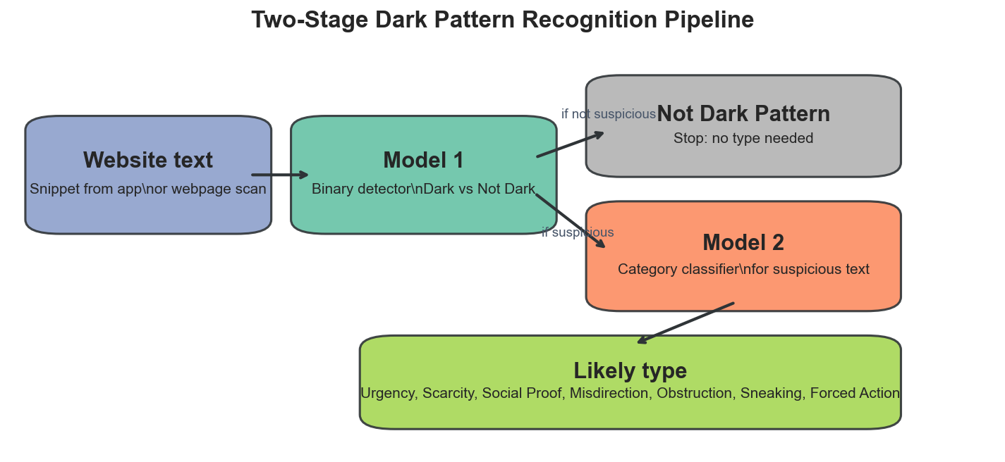
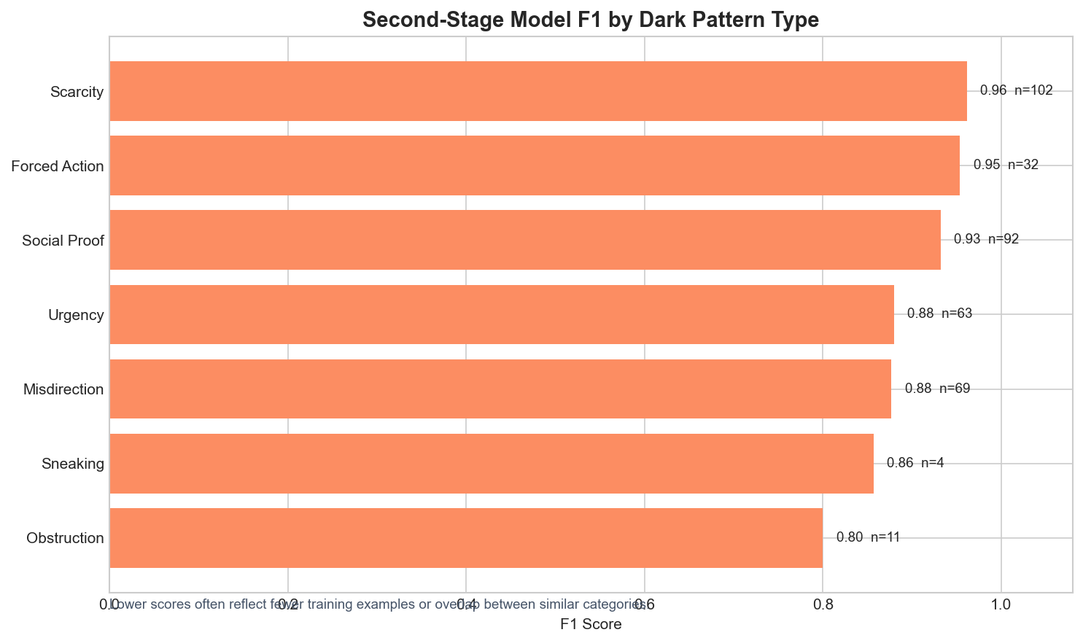
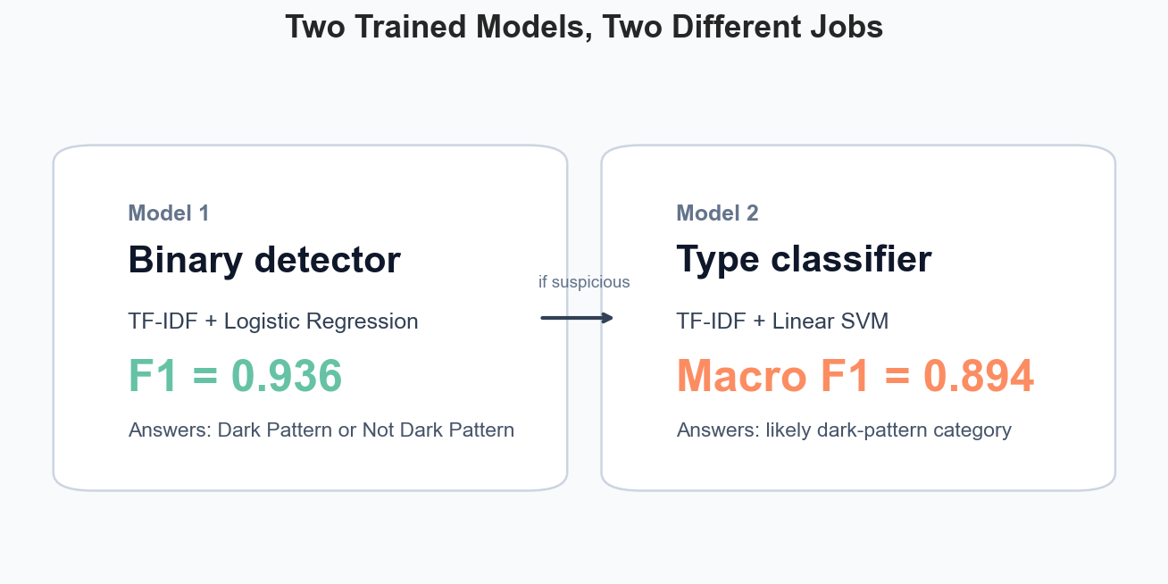
Dark Pattern Recognition
Two trained models: detect suspicious text, then explain likely type
AI4ALL Ignite Team 20C | Supervised NLP for E-Commerce Text
Research Question
Two-Model Demo Flow
Results
Can supervised text classifiers detect dark-pattern language, and what are the limits of text-first detection?
Model 1
F1 0.936, accuracy 93.9%
Model 2
Macro F1 0.894
Data
Primary binary: 2,356 balanced snippets
Category model: 1,861 dark-pattern rows
Labels: Urgency, Scarcity, Social Proof, Misdirection, Obstruction, Sneaking, Forced Action
Category Performance
Responsible AI
Predictions are review signals, not accusations.
False positives can unfairly flag normal marketing.
Text-only models miss layout, buttons, images, and flows.
Demo
Streamlit: analyze text + scan webpage
Shows main answer, confidence, likely type
Filters reduce low-context false positives
github.com/RadRebelSam/ai4all-20c-darkpatterns | radrebelsam.github.io/ai4all-20c-darkpatterns

